Slide 1
Flood Area Re-Use Recommendations
Presented to the Franklin Park Board by the
Franklin Flood Area Re-Use Committee
Tuesday, November 15, 2011
4:00 p.m.
Franklin Cultural Arts and Recreation Center

Slide 2
About the
Franklin Flood Area Re-Use Committee
Committee of concerned citizens (includes flood victims).
Members of the Committee: Eva Aldrich (Chair), Joe Abban, Pam Ault, Michelle Dahl, Doug Grant, Rob Henderson, and Mike Wilson. For the City of Franklin: Zach Burton, Joanna Myers, Chip Orner.

Slide 3
Committee Mission
The Franklin Flood Area Re-Use Committee will gather ideas from the community on what should go in the new park created from land that was devastated by the 2008 flood.
The new park should be something that people will enjoy, that fits in with the surrounding neighborhood, and that follows FEMA guidelines.
Two key considerations:
  Because of current limited funding, need a plan that is low cost and that can be implemented as funds are available.
  Balancing the wishes of those in the affected neighborhoods to maintain quiet and privacy with the recreational needs of a vibrant community.

Slide 4
Context: Key Events of the Flood
June 7, 2008: The flood occurs.
July 3, 2008: 1st Public Meeting.
December 3, 2008: IDHS application submitted.
March 18, 2009: FEMA application submitted.
September 25, 2009: Grant awarded.
March 24, 2010: 1st house purchased.
May-October 2011: Committee gathers citizen input at community events and through social media:
  Fourth Fridays
  Fireworks Festival
  Johnson Co. Fair
  Survey by FC Students
  Public Forum
  Fall Festival
  Mayoral meeting with grade schoolers
  Dedicated e-mail address
  Facebook page
November 2011: Committee compiles responses and makes recommendation to Franklin Park Board on re-use of the flood area.

Slide 5
Dimensions of the Re-Use Area
Approximately 12 acres
Borders:
  On the north: South Street
  On the south: Frank’s Place
  On the east: Center Street
  On the west: Nineveh Street
Number of houses destroyed: Approximately 70

Slide 6
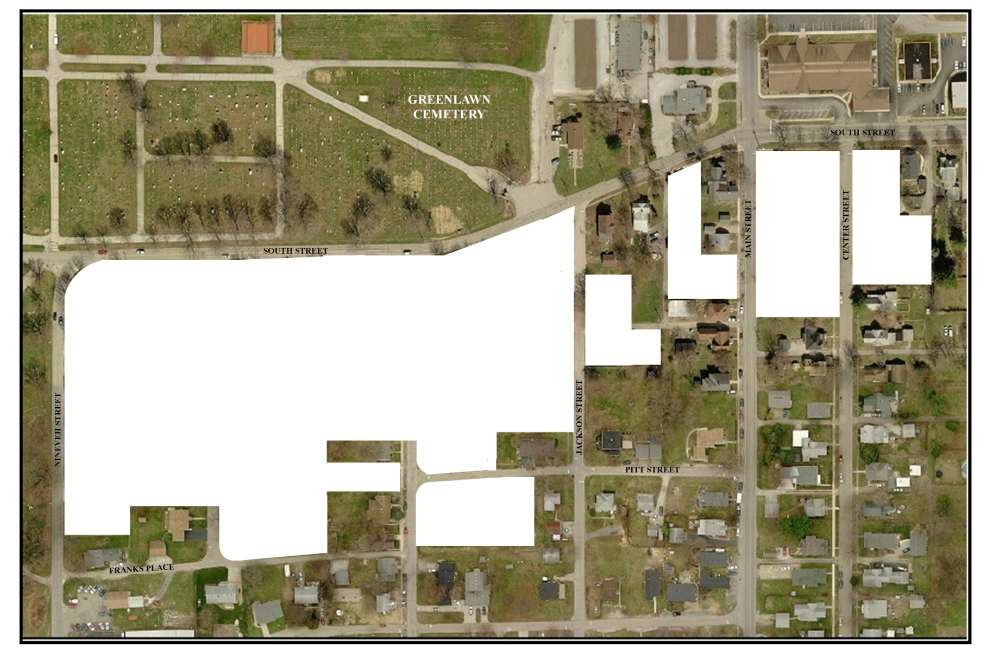
Dimensions of the Re-Use Area

Slide 7
Restrictions on Flood Area Re-Use
Land has restrictions placed on it by FEMA.
Key restrictions:
  Very little pavement, etc.—need to keep it so that the land can soak up rain, etc.
  No insurable structures or structures with walls.
  Full list of restrictions available upon request.
Funding has yet to be identified for improvements beyond basic maintenance.

Slide 8
Franklin’s Opportunity
To create a welcoming, enjoyable space that fits in with the surrounding neighborhood.
Overview of feedback received (handout).

Slide 9
The Committee’s Recommendation
In large area:
  Baseball practice field with parking
    Low impact and low cost—no lighting, no dugouts, etc.
    Replaces one Province Park field lost in 2008 flood.
  Green buffer (trees, grasses, other plantings) provides separation between baseball practice field and surrounding homes.
In smaller areas:
  Maintain as lawn
    Add decorative plantings to add beauty and to buffer nearby homes.
    Add benches to encourage use of area for reading, talking, etc.
    Area can also be used for informal lawn games (croquet, lawn bowling, horseshoes, etc.) with people bringing own equipment.
  Gazebo as centerpiece to designate area as park
    Include plaque in remembrance of 2008 flood.
Seek help from community groups to fund

Slide 10
The Committee’s Recommendation
(Rough Illustration—Not to Scale)
G
Baseball practice field
Parking
Buffer
Buffer
Buffer

Slide 11
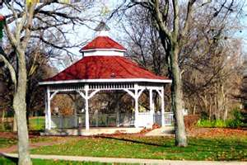
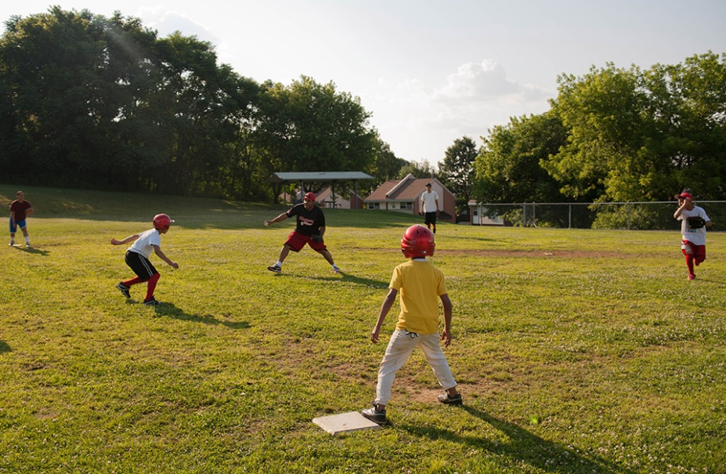
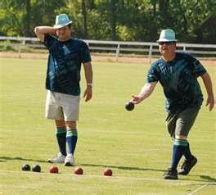
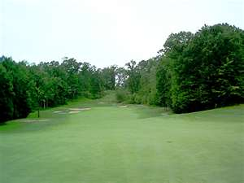
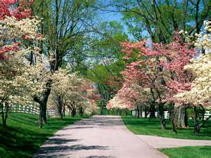
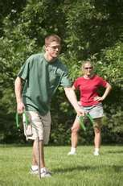
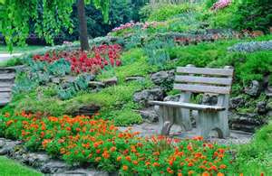
Some Pictures of the Possibilities

Slide 12
Comments and Questions?

