Slide 1
Franklin Mayor’s Youth
Leadership Council
Baby Box Project

Slide 2
FMYLC
President: Jenna Newton, Vice President: Lillian Lacy, Secretary: Liam Clarke Communications Chair: Kinley Shoemaker
Sponsorers: Mayor Barnett, Tara Payne, Anne McGuinness
We are a high school organization that works with the City of Franklin to encourage involvement in local civics.
Notes:
Jenna (City Council), Kinley (Board of Works)

Slide 3
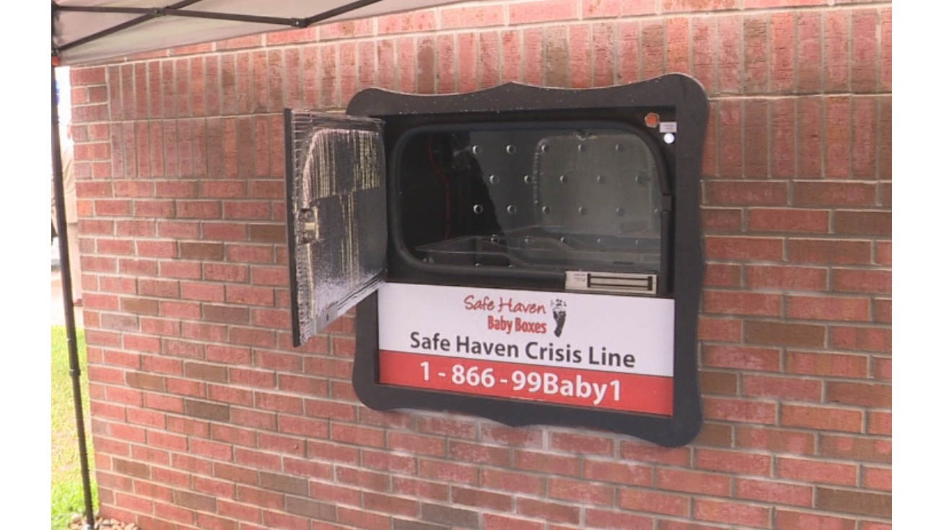
Baby Box
Location for parent to legally surrender a baby
Safely, securely, anonymously
Prevents unsafe infant abandonment
Raises awareness
Parent does not fear arrest or prosecution
Location:
Fire Station 22 off of King Street
Installed in exterior wall
Notes:
Lilly(City Council), Maggie (Board of Works)

Slide 4
Procedure Outline
Safe Haven Baby Box program information reviewed by Fire Chief, Matt Culp
Contract signature by city attorney, Lynn Gray
Signed contract and payment sent to SHBB
Baby Box order placed
Production takes 4 to 6 weeks
Baby box delivery is scheduled with provider
Baby Box installed by licensed contractor
Alarm testing, training for provider personnel
Baby box unveiling and availability for community members
Annual duties
Ongoing support/ awareness, annual inspection and recertification, contract renewal
Notes:
Kinley (City Council), Zoe (Board of Works

Slide 5
Financial Details
(Total of ~$15,000):
Initial Fee: $10,000
“Pre-installation” Services
Installation Services
Post Installation Services
Other fees not included in the installation fee (Estimated at $5,000):
Installation: labor and materials ~$2,000-$3,500
Electrical and Alarm: hook up to internal alarm system (Internal alarm must go to
911 dispatch for use with the baby box) ~$1,200
Annual Alarm Service: Annual fee for monitoring ~ $200 to $300 annually paid by location to
Alarm Company
Permits or other requirements prior to construction. (prices vary)
Notes:
Liam (City Council), Kinley (Board of Works

Slide 6
Thank you!

