Slide 1
Franklin Parks and Recreation
March 2025 Park board Meeting

Slide 2
FACILITY Reservations
All exercise classes have been moved to Beeson Hall for the summer due to camp taking over the Theater. So far, everything has been going pretty well with having classes in the morning/evening and then camp in there during the day for rainy days.
Concessions at Scott Park will be done at the end of this month. They will be having the Mercer Tournament out there on the 28th and 29th and then our season out there is finished.
Rentals at the pool have been going okay. We have had to reschedule a few things at the pool due to weather but we’ve gotten them in as best we can.
- Jamie

Slide 3
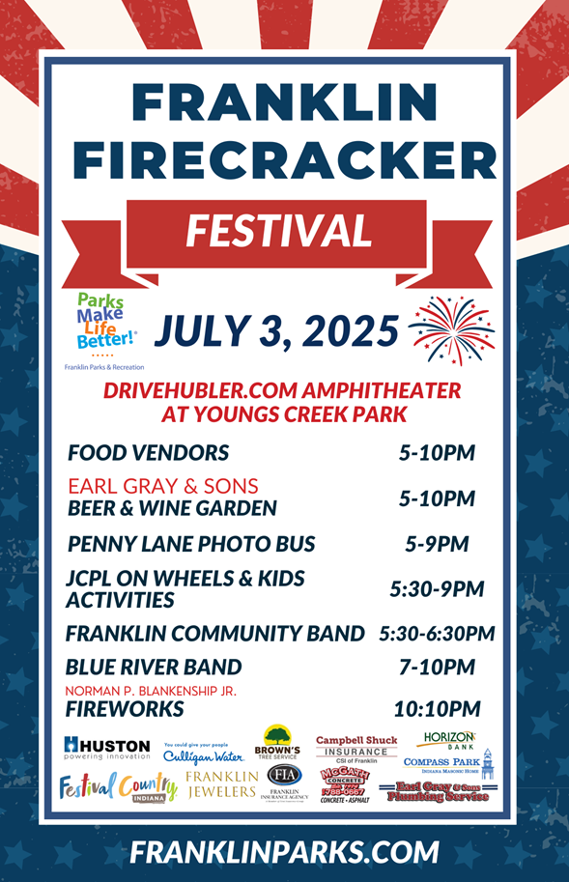
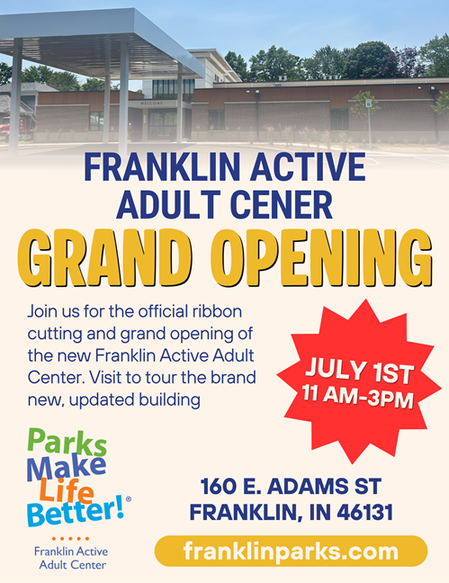
Sent: 3,534
Opened: 1,570 (48%)
Clicked: 134 (8.5%)
Most opened links:
June Fitness Calendar
Aquacise
Aquatic Programs
Cruisin the Amp poster
New Sign Ups : 4
Created this graphic for the new AAC building ribbon cutting!
Poster for Firecracker Festival!
With the help of Curtis and Holly, I created a new entrance to the Beer & Wine Garden, with new updated signage!

Slide 4
- Victoria
Facebook:
Franklin Parks & Recreation
Follower Count: 18, 308 (+388)
Like Count: 14,634 (+191)
Most liked post: “Long Live Amp Concert”
Number of Likes: 267
Number of shares: 46
Number of comments: 24
Instagram: @franklinparksin
Follower Count: 1,980 (+79)
Most liked post: “Show me how you break it down, FFAC Tikok”
Number of likes: 159
Number of comments: 5
Number of sends: 22
Accounts reached: 4,903
Twitter (x): @franklinparksin
Follower Count: 1,062 (+1)
Most liked post: Summer Concert Series Announcement
Number of Likes: 8
Number of Impressions: 790
Number of replies: 0
TikTok: @franklinparksin
Franklin Parks & Recreation
Follower Count: 1,020 (+5)
Like Count: 2,212 (+131)
Most viewed post: “Show me how you break it down, FFAC Tikok”
Number of views: 568
Number of likes: 23
Number of saves: 1
Number of comments: 1
As of June 18th

Slide 5
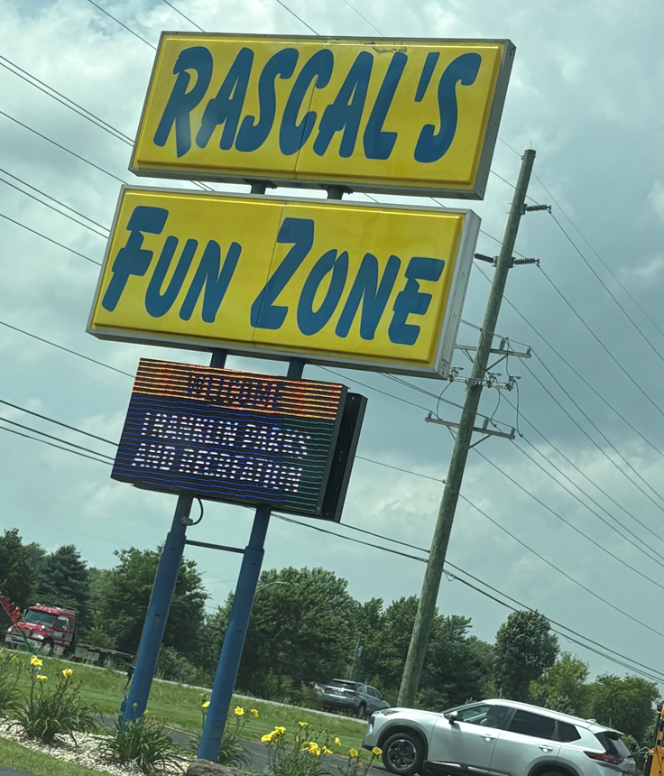
Recreation pROGRAMS
KICKAPOO KIDS CAMP
Camp is full swing! If you could send all the rain somewhere else that would be great! We have had a lot of indoor days and the kids (and counselors) would love one normal week!
I have already received multiple emails and three sticky notes from the front desk to get on the KKC 2026 Email List.
We have been skating, Kids Empire, Conner Prairie, and to Rascals so far!
First concession stand day is Friday and the kids are so excited!
- Courtney

Slide 6
Recreation pROGRAMS CONTINUED
COMMUNITY GARDEN
The gardens look amazing!! Please drive by and see all the amazing things growing from our gardeners.
OUR TOWN PLAYERS
They are so excited for the New Active Adult Center Auditorium and to have their anniversary show there at the end of summer.
PAAC and Art Programming
During summer this kind of takes a break. I have already scheduled a canvas painting class for September, a DIY wreath making for November, and a couple others. If there are any “art” programs that you would like to see please let me know! We love having all of the different textiles for people to try!
- Courtney

Slide 7
RecreatioN, Events, & pROGRAMS
Programs
Created parks and recreation month activity calendar for July to offer free programming to showcase different areas in our parks and celebrate the importance of parks and recreation.
Coordinating upcoming fall recreational programs/classes such as a woodcarving class, a pottery class with a Franklin college art student instructing it, and beginners ballet.
Franklin Friends Adaptive program is focusing on going outside and using park spaces/shelters during the summer to offer a wider variety of activities to participants.
Lifeguards are in the swing of things for the summer and the new staff have done a great job of learning and asking questions from returning staff.
Non- City Events
No Updates
-Nick

Slide 8
Community events
PROGRAMMING:
The season started off with the weather not cooperating. We got Cruisin’ the Amp in but our crowd was not large because of the on and off rain. Arts @ the Amp events have gone well. We had 100 people at Zumba last Friday and it was so much fun! Our oldest participant was 80 and the youngest was 4. The Arts @ the Amp concert with the Franklin Community Band was wonderful as always. The weather was great and we had 100+ people in attendance. Planning for the Active Adult Center opening has been fun. We are excited to see it all come together. Here is a list of upcoming events:
Saturday, June 21 Concert: Long Live (Taylor Swift Tribute) 5:30-10:00pm
Thursday, June 26 Arts @ the Amp: 905 South Main Quartet 7:00-8:00pm
Friday, June 27 Arts @ the Amp: Zumba 9:00-10:00am
Thursday, July 3 Firecracker Festival 5:00-11:00pm
Monday, July 7 Arts @ the Amp: 38th Infantry Division Band 7:00-8:30pm
Wednesday, July 9 Arts @ the Amp at Beeson Hall: Happy Enchiladas 7:00pm
*Partnership with Franklin Symphonic Council
Friday, July 11 Arts @ the Amp: Zumba 9:00-10:00am
CONCESSIONS
Concessions at Scott Park and the pool are going well. Again, the weather is not cooperating but we are doing what we can.
SPONSORSHIPS AND GRANTS:
On the next slide are the sponsors we have secured so far. Please let me know if you have anyone we should contact.
-Holly

Slide 9
Community events continued
Sponsor List for 2025
Concert Series
Festival Country Indiana, Title Sponsor ($10,000)
Earl Gray & Sons, Beer & Wine Garden Sponsor ($7,500)
Compass Park, Gold Sponsor ($5,000)
Franklin Jewelers, Gold Sponsor ($5,000)
Huston Electric ($5,000 In Kind)
Campbell Shuck Insurance, Silver Sponsor ($2,500)
Franklin Insurance, Silver Sponsor ($2,500)
Culligan ($2,500 In Kind)
Horizon Bank, Silver Sponsor ($2,500)
McGath Concrete Construction Corporation, Silver Sponsor ($2,500)
Dolce Bella Aesthetics, Booth Sponsor ($500) **NEW
Frame It Unique Optical, Booth Sponsor ($500) **NEW
Horizon Bank, Booth Sponsor ($500)
ISG Property Group, Booth Sponsor ($500)
Ivy Tech Community College, Booth Sponsor ($500)
Martin Orthodontics, Booth Sponsor, ($500)
Rise Recovery Coalition, Booth Sponsor ($500)
Easter Egg Hunt
Community Baptist Church, Title Sponsor ($750)
Earl Gray & Sons, Gold Sponsor ($500)
Cruisin’ the Amp
Winters Plumbing, Gold Sponsor ($1,500)
Firecracker Festival
Fall Festival
Winters Plumbing, Gold Sponsor ($2,500)
Summers Plumbing Heating & Colling, Gold Sponsor ($2,500)
Martin Orthodontics, Silver Sponsor ($1,000)
Halloweentown
Tri Kappa, Title Sponsor, ($4,000) ** NEW
Summers Plumbing Heating & Cooling, Silver Sponsor ($1,000)
Earl Gray & Sons, T-shirt Sponsor, ($250)
Family Movie Series
JCREMC/JCFiber, Title Sponsor ($5,000)
Earl Gray & Sons, Silver Sponsor ($500)
Franklin Family Aquatic Center
Vaught Family Eye Care, First Aid & Sunscreen Sponsor ($500)
Lambert Orthodontics, Souvenir Cub Sponsor ($1,000)
Hubler Group Amphitheater Sponsorship ($25,000)
Johnson Memorial Hospital Pickleball Sponsorship ($25,000)
Branigin Foundation Street Sponsorship ($10,000)
Branigin Foundation Arts at the Amp Series and programming with the Franklin Public Arts Advisory Committee ($5,500)
-Holly

