Slide 1
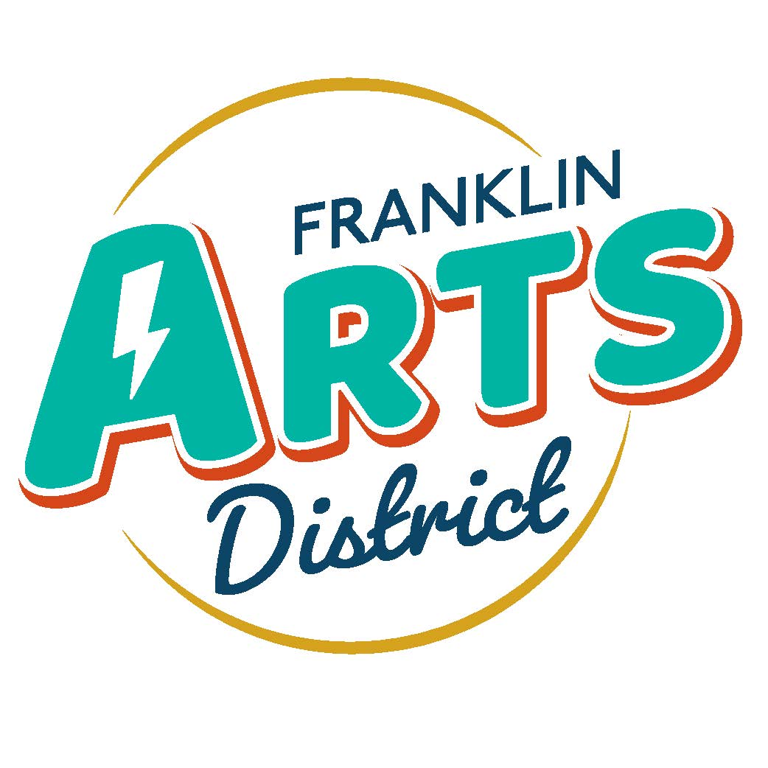
Grant Opportunities for PAAC
February 8, 2024

Slide 2
180 In Color matching grant $45,000 Competitive and matching
Project: Activation of Veteran’s Alley. Metal Flag, overhead arches and lights, and bench with soldier.
Match available from Indiana Public Art Commission of $15,000, $10,000 from JCCF, and apply for EDC grant.

Slide 3
READI Lilly Grant for Art. Will apply for $400,000, no award amount known at this time.
Lilly will provide $250,000,000 for blight remediation and public art projects. This fits both. No info on match or maximum award at this time.

Slide 4
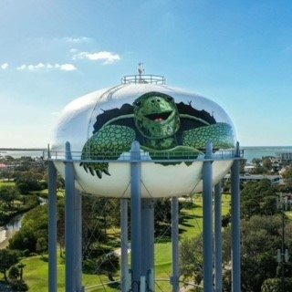
JCCF Gift VIII program. $3,000,000 total for a number of projects. One is a capital and capacity project. Could use for Water Tower match or for partnering with FDC and FHI on rehabilitation of downtown building to include art gallery

